Slide 1




TRAINING REPORT
JAVASCRIPT
Submitted To : Dr. Nidhi Shrivastava
Submitted By : Rishabh Dhayal
20ESKCA051
Artificial Intelligence

Slide 2


COURSERA
U.S.-based massive open online course provider.
founded in 2012^{[6][7]} by Stanford University computer science professors Andrew Ng and Daphne Koller.
Coursera works with universities and other organizations to offer online courses, certifications, and degrees in a variety of subjects.
In 2021 it was estimated that about 150 universities offered more than 4,000 courses through Coursera.

Slide 3






Slide 4




Slide 5


Slide 6




Slide 7


JAVASCRIPT
LANGUAGE OF WEB

Slide 8


Light Weight
Scripting Language

Slide 9

Interpreter Based
Case Sensitive

Slide 10

Event Handling
Object Oriented

Slide 11


Simple Client-side Calculations
Handling Dates and Time
Generating HTML Content
DOM Manipulation
Platform Independent
Validating User’s Input
Dynamic Typing
Detecting the User’s Browser and OS

Slide 12


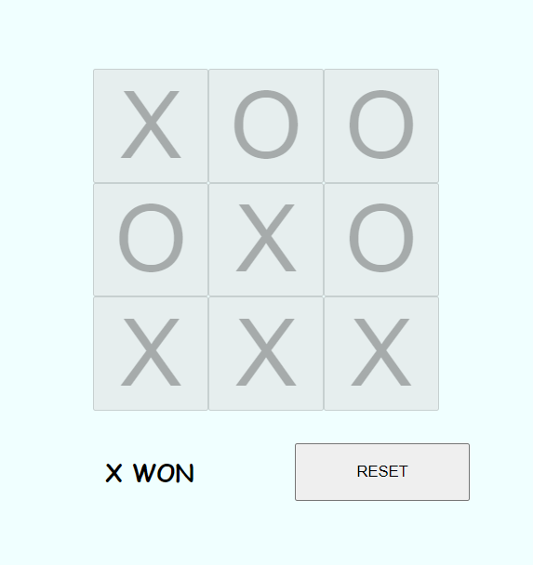


Projects
1. Interactive TIC TAC TOE

Slide 13
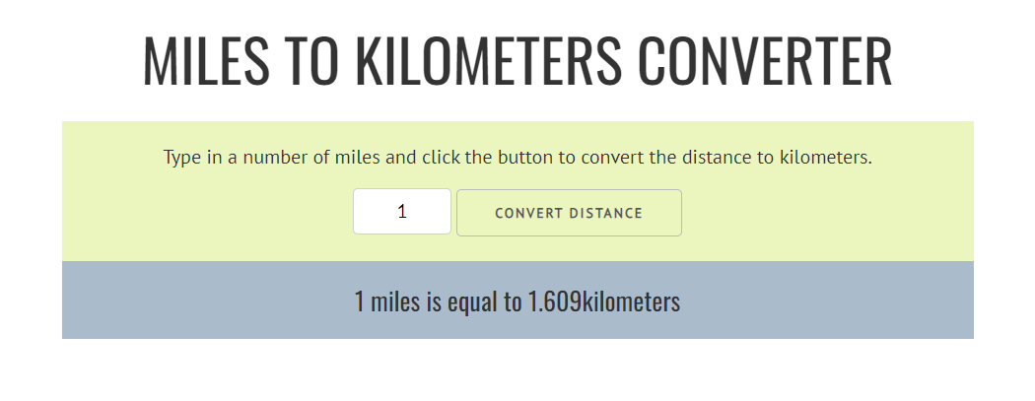
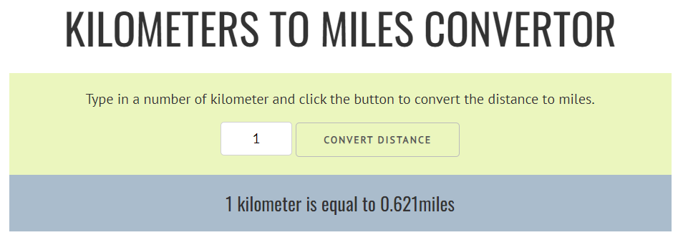


Projects
2. Distance Convertor

Slide 14
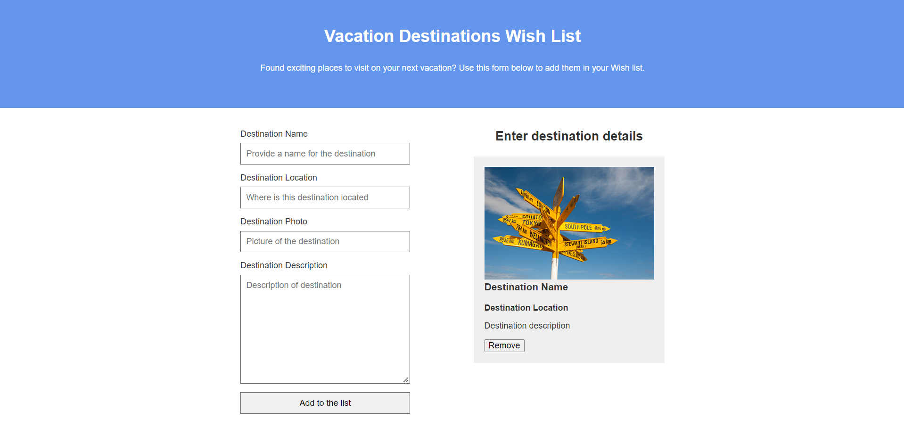


Projects
3. Vacation Wish List

Slide 15
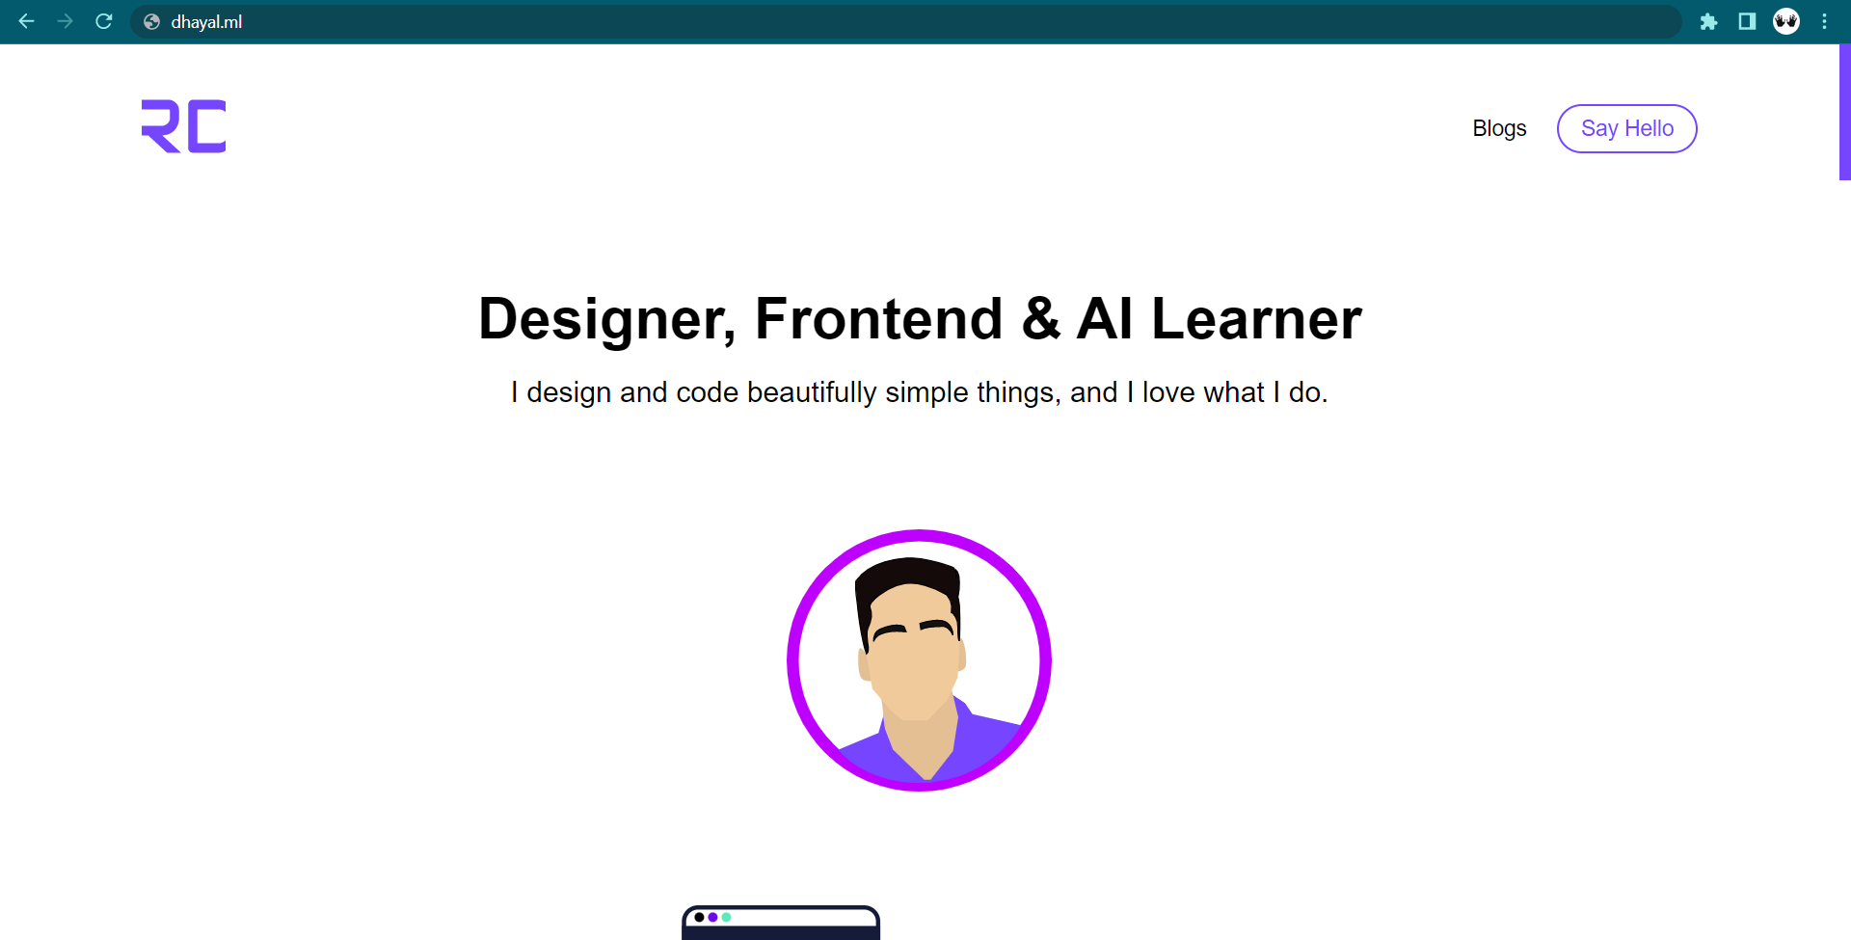


Projects
4. Portfolio Website

Slide 16

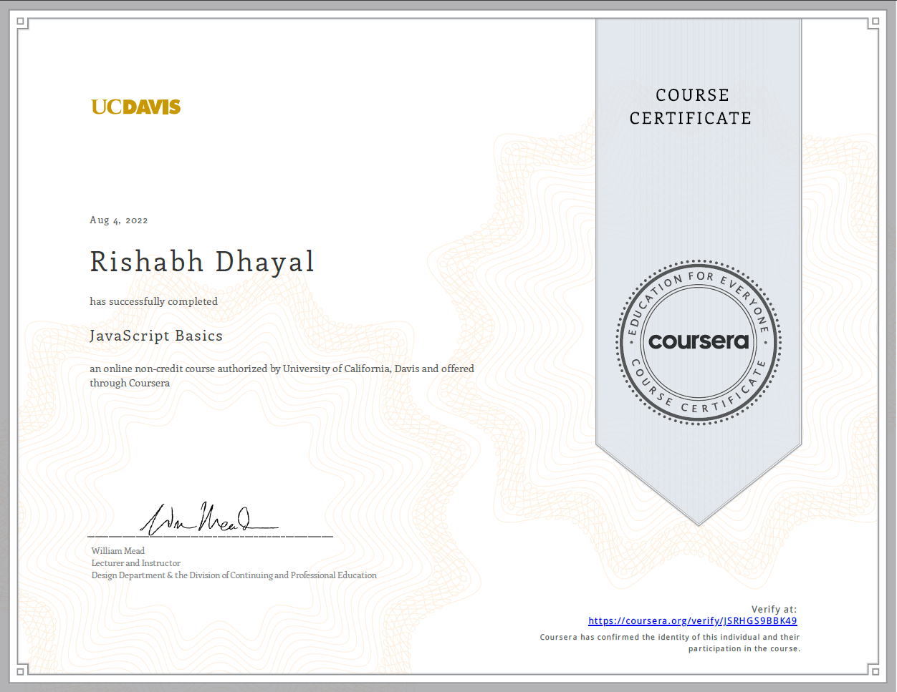


Certificate

Slide 17


Any Query ?

Slide 18



Slide 19


Thank you

